Slide 1

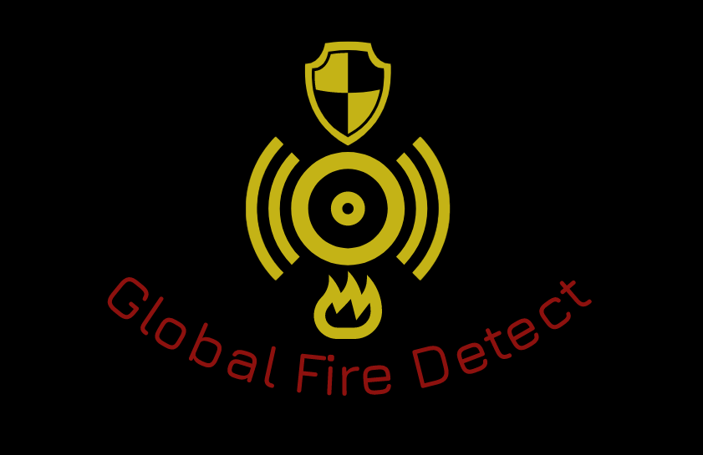

Global Fire Detect
NASA International Space Apps Challenge

Slide 2

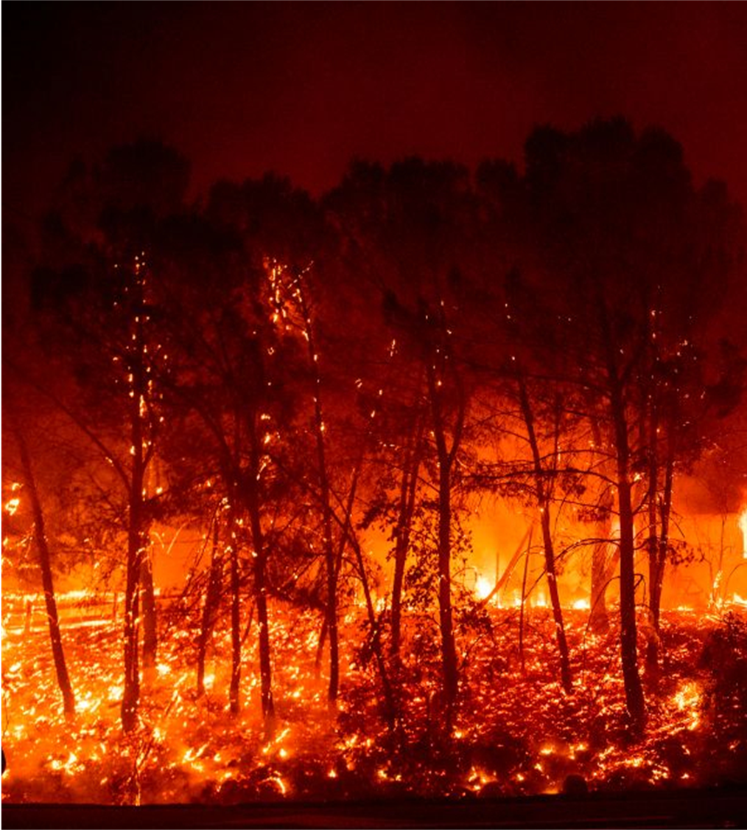
Purpose of the App
Help to prevent forest fires
Assist to the firefighters to detect quickly the fires
Report to the people what to do in a fire
Provide a map to know which zones are more prone to a fire
Visualize the areas which are most probable to spread the fire.

Slide 3




Features of the App
The App has a map that uses the MODIS/SMAP sensors.
On the map are indicated burned zones (red colour).
Zones already burned (yellow colour).
Zones with a low chance of fire (green colour).
POINT:
Burning areas
Possible fire zones
Zones already burned
Zones with a low chance or fire

Slide 4
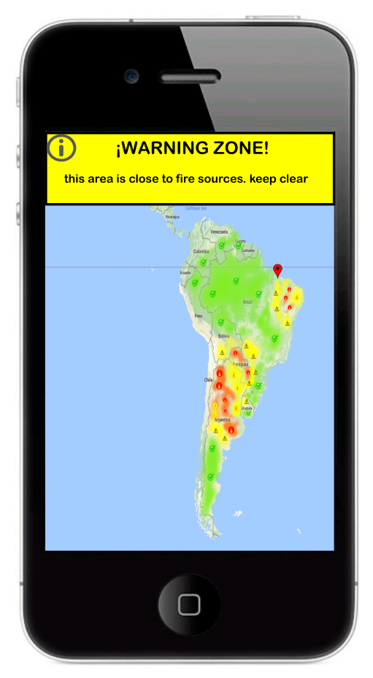
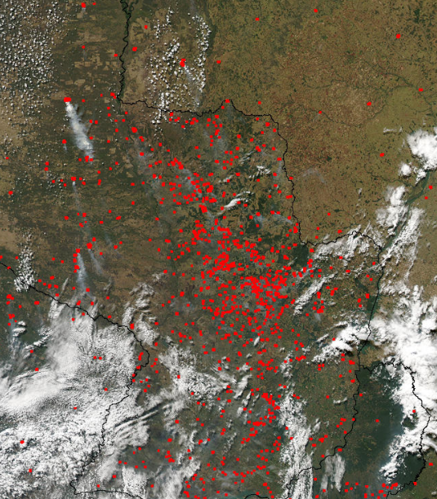
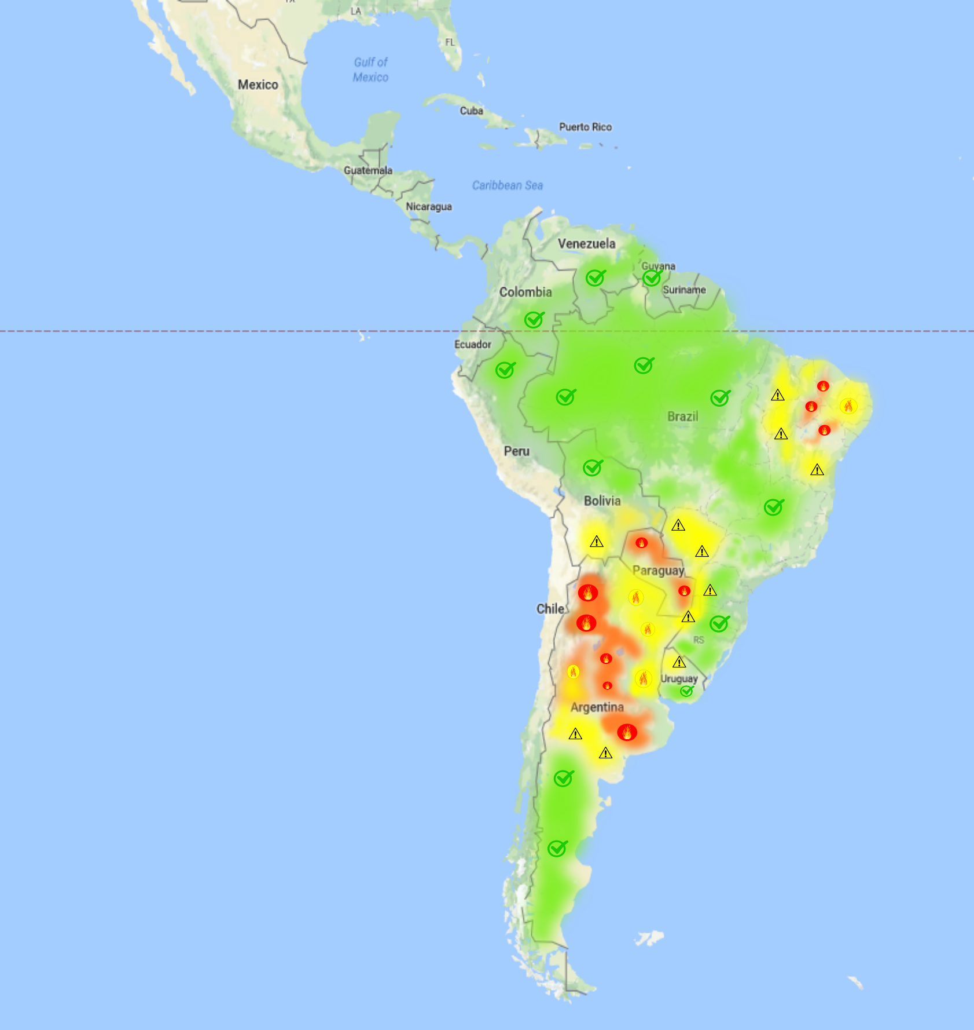
Functioning of the App
General map of the affected zone
Concrete map of the fire zone

Slide 5
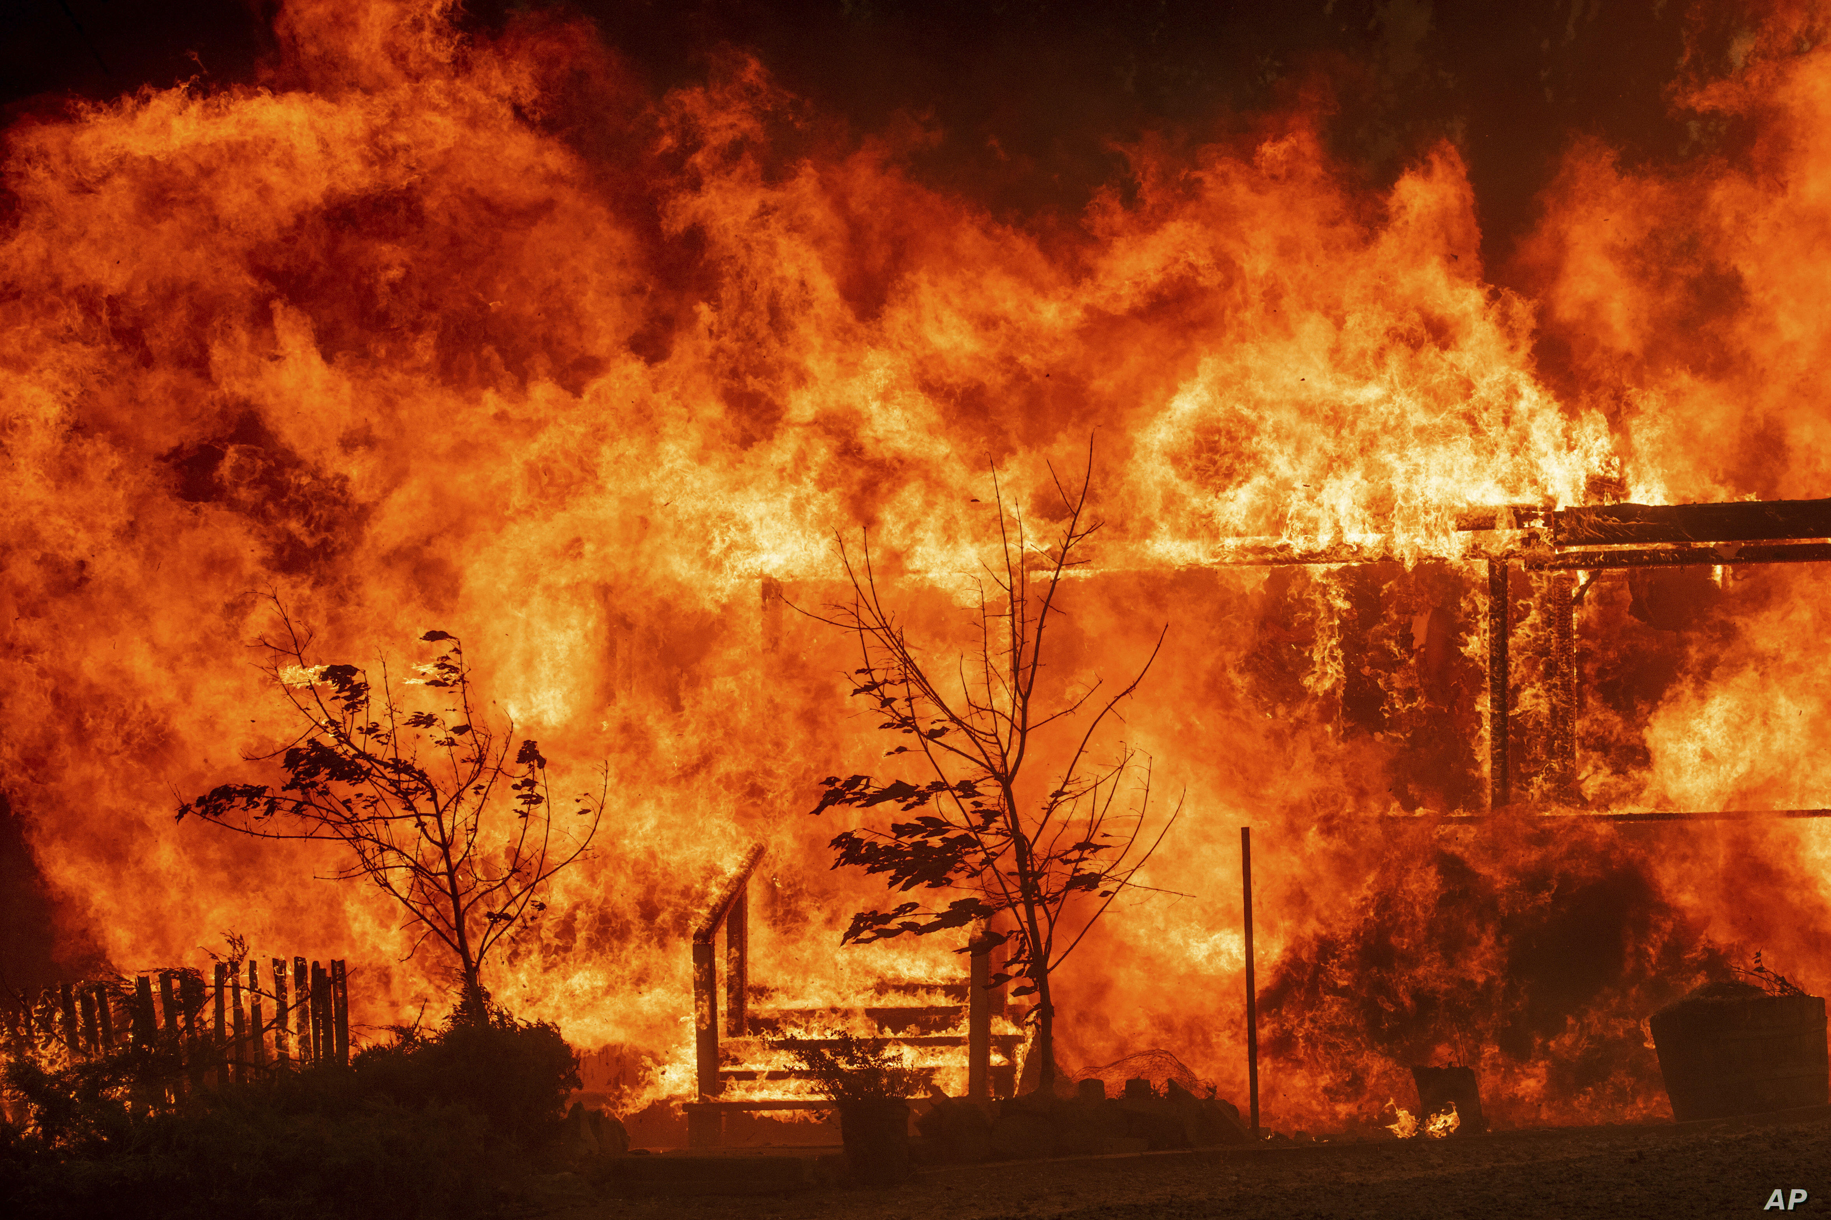
Fire categories
Level I. Small fires. To be controlled, it requires just volunteer staff of the comunities.
Level II. Medium fires. To be controlled, it requires the participation of other institutes like Civil Protection, Secretary of National Defense, Municipal Government and other instances of Estatal Government.
Level III. High fires. It requires the participation and resources of other institutes of the Federal Government.

Slide 6
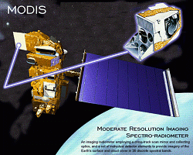
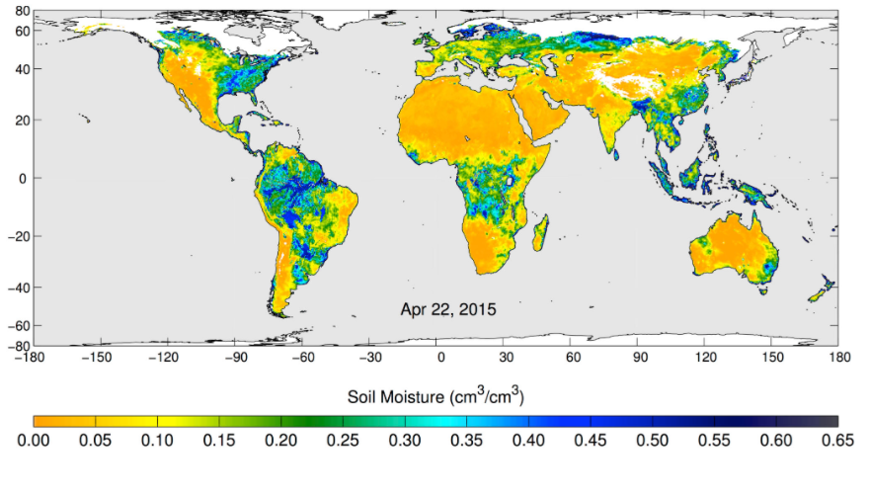
The sensors used in the App
MODIS sensor (Moderate Resolution Imaging Spectroradiometer): the MODIS sensor is a sensor that identifies the rared radiation emitted by fires. This radiation can be traslated quickly into a map where they are shown all fire spots
SMAP sensor (Soil Moisture Active Passive): SMAP sensor is designed to measure soil moisture, every 2/3 days. This allows to observe changes on all the world in timescales ranging from major storms to repeated measurements of changes throughout the seasons

Slide 7
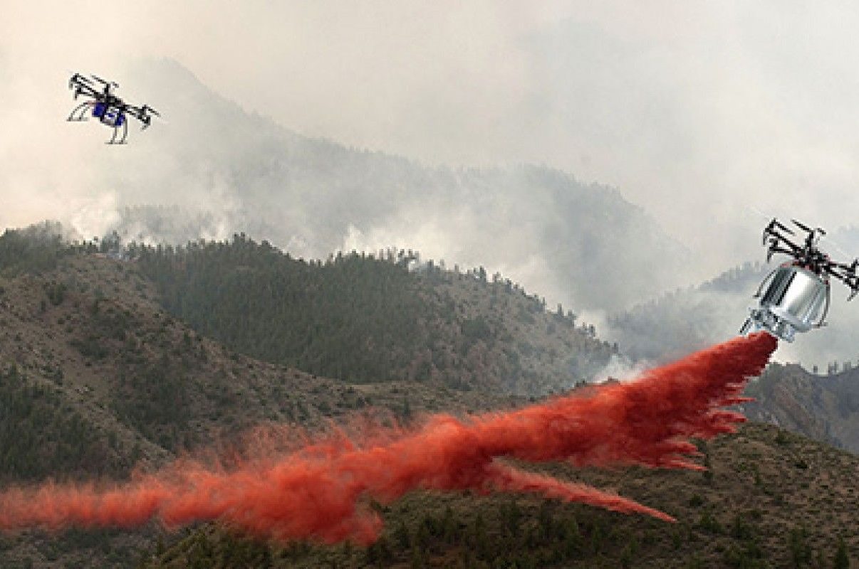
Tecnologies used in the fires
Another of the most used technologies is the use of drones, that allows to reduce costs to prevent or detect more efficiently and quickly any posible fire. Also it avoid put in risk the people´s lifes to reach into places with difficult Access. It could be used with the App to remove the detected spots by the MODIS sensor and avoid a bigger fire.

